Slide 1
Substation and Distribution Automation
Module 3: Distribution level power flow

Slide 2
Module 3 Overview
Part 1 - Review of Balanced Powerflow Techniques
Part 2 - Forward Backward Sweep (FBS) Method
Part 3 - Three Phase Current Injection (TCIM) Newton Raphson (NR) Method

Slide 3
Part 1 - Review of Balanced Power Flow
Powerflow is the fundamental analysis tool and provides the input information for many planning and operations tools.
Powerflow was originally developed only for the transmission level because of the cost of computing.
To further reduce computing requirements a number of assumptions were made:
Balanced system
Transposed transmission lines
Loads are constant power

Slide 4
The Powerflow Problem
The goal of powerflow is to determine the voltage and angle at all nodes in the system, when given the end-use load and generator inputs.
To relate the two sets of variables the powerflow problem breaks the system into two concepts:
Power injections
Network formulation

Slide 5
The Powerflow Problem Cont.
Power Injections
Network Formulation

Slide 6
Power Injections
Injection of power at a node is from the perspective of the interconnecting transmission system.
A positive injection indicates generated power.
A negative injection indicates consumed power.
The node injections are generally known for all but one bus in advance. This is known as the swing or slack bus.
The net complex power injected into a bus is given by
$S_{i}=P_{i}+{jQ}_{i}=\left(P_{Gi}−P_{Di}\right)+j\left(Q_{Gi}−Q_{Di}\right)$ (1)
where complex power supplied by the generator is:
$S_{Gi}=P_{Gi}+{jQ}_{Gi}$ (2)
and the complex power consumed by the loads is:
$S_{Di}=P_{Di}+{jQ}_{Di}$ (3)

Slide 7
The Network Formulation
In addition to the power injections that occur due to the generators and the loads, power flows into and out of each node on the interconnecting lines.
These flows are not injections from the perspective of the transmission system, they are simple flows between nodes.
Given the voltage and angle at the nodes on either end of a line, the flows can be determined.
Because of the potentially large number of nodes and links, these equations are formulated with sets of equations.

Slide 8
The Network Formulation Cont.
The network consists of the lines and transformers that connect the nodes of a system.
While the diagram shows only a single line, three phases are actually represented.
The power that is injected at the nodes flows across the lines.

Slide 9
The Network Formulation Cont.
The “pi” model is a common representation for a transmission line.
There are two parts:
A series impendence
Two shunt capacitances
The pi model is adequate for a single line section when solving for a steady state values, i.e. powerflow.

Slide 10
The Network Formulation Cont.
A node will often have multiple lines connected to it.
The capacitance values from the multiple lines can be combined into a single effective value.
The resultant model is a series impendence between each node, and a single shunt value.

Slide 11
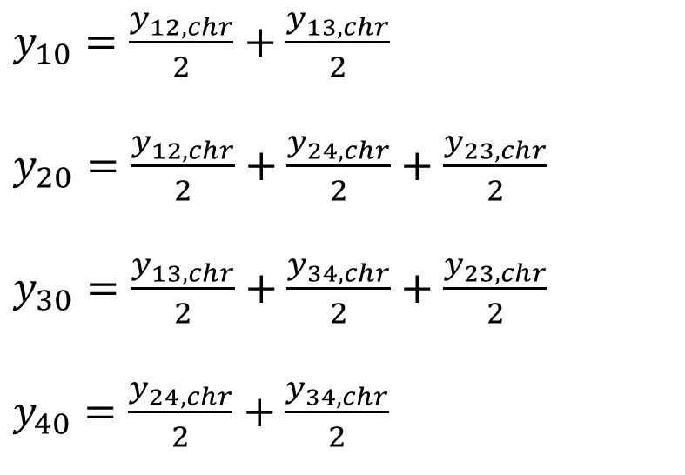
The Network Formulation Cont.
The lumped shunt capacitance values can determined using the equations of (4).
$y_{10}=\frac{y_{12,chr}}{2}+\frac{y_{13,chr}}{2}$
$y_{20}=\frac{y_{12,chr}}{2}+\frac{y_{24,chr}}{2}+\frac{y_{23,chr}}{2}$
$y_{30}=\frac{y_{13,chr}}{2}+\frac{y_{34,chr}}{2}+\frac{y_{23,chr}}{2}$
$y_{40}=\frac{y_{24,chr}}{2}+\frac{y_{34,chr}}{2}$
(4)

Slide 12
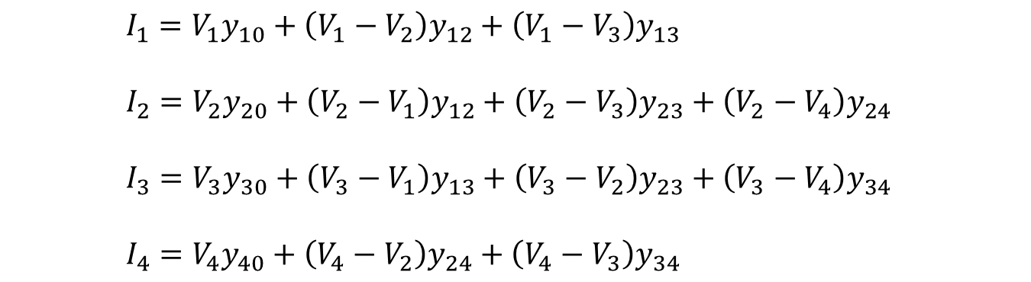
The Network Formulation Cont.
Besides the ground node, there are four other nodes (buses) at which the current from the sources is injected into the network.
Applying Kirchhoff’s current law (KCL) at nodes 1,2,3 and 4, respectively, to get the following four equations:
$I_{1}=V_{1}y_{10}+\left(V_{1}−V_{2}\right)y_{12}+\left(V_{1}−V_{3}\right)y_{13}$
$I_{2}=V_{2}y_{20}+\left(V_{2}−V_{1}\right)y_{12}+\left(V_{2}−V_{3}\right)y_{23}+\left(V_{2}−V_{4}\right)y_{24}$
$I_{3}=V_{3}y_{30}+\left(V_{3}−V_{1}\right)y_{13}+\left(V_{3}−V_{2}\right)y_{23}+\left(V_{3}−V_{4}\right)y_{34}$
$I_{4}=V_{4}y_{40}+\left(V_{4}−V_{2}\right)y_{24}+\left(V_{4}−V_{3}\right)y_{34}$
(5)

Slide 13
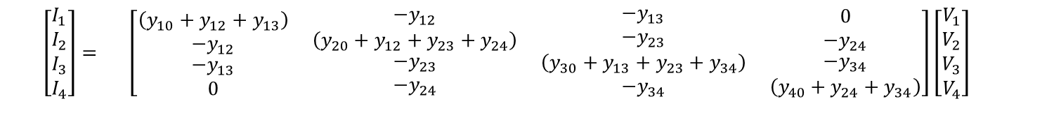
The Network Formulation Cont.
Rearranging and writing in matrix form gives:
$\left[\begin{matrix}I_{1} \\ I_{2} \\ \begin{matrix}I_{3} \\ I_{4}\end{matrix}\end{matrix}\right]=$ $\left[\begin{matrix}\left(y_{10}+y_{12}+y_{13}\right) \\ {−y}_{12} \\ \begin{matrix}{−y}_{13} \\ 0\end{matrix}\end{matrix} \begin{matrix}{−y}_{12} \\ \left(y_{20}+y_{12}+y_{23}+y_{24}\right) \\ \begin{matrix}{−y}_{23} \\ {−y}_{24}\end{matrix}\end{matrix} \begin{matrix}{−y}_{13} \\ {−y}_{23} \\ \begin{matrix}\left(y_{30}+y_{13}+y_{23}+y_{34}\right) \\ {−y}_{34}\end{matrix}\end{matrix} \begin{matrix}0 \\ {−y}_{24} \\ \begin{matrix}{−y}_{34} \\ \left(y_{40}+y_{24}+y_{34}\right)\end{matrix}\end{matrix}\right]\left[\begin{matrix}V_{1} \\ V_{2} \\ \begin{matrix}V_{3} \\ V_{4}\end{matrix}\end{matrix}\right]$
(6)
Equation (6) is for a system with 4 nodes, but the general formulation can be expanded to include any number of nodes.
When the correct values of voltage are known, the currents calculated in equation (6) will equal the currents of the node injections from generation and load.

Slide 14
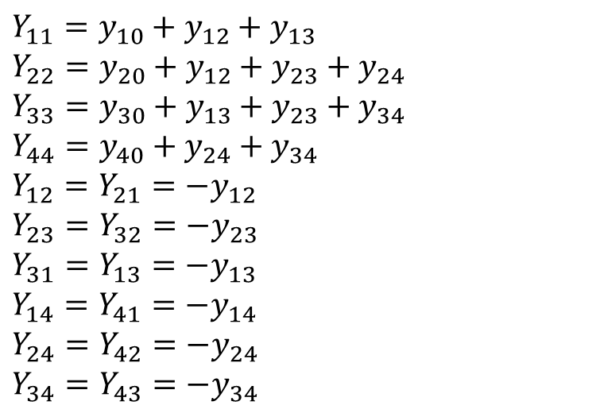
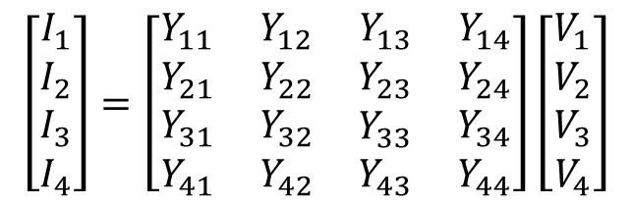
(7)
Equation (7) can be recognized to be of the standard form:
$Y_{11}=y_{10}+y_{12}+y_{13}$
$Y_{22}=y_{20}+y_{12}+y_{23}+y_{24}$
$Y_{33}=y_{30}+y_{13}+y_{23}+y_{34}$
$Y_{44}=y_{40}+y_{24}+y_{34}$
$Y_{12}=Y_{21}=−y_{12}$
$Y_{23}=Y_{32}=−y_{23}$
$Y_{31}=Y_{13}=−y_{13}$
$Y_{14}=Y_{41}=−y_{14}$
$Y_{24}=Y_{42}=−y_{24}$
$Y_{34}=Y_{43}=−y_{34}$
$$\left[\begin{matrix}I_{1} \\ I_{2} \\ \begin{matrix}I_{3} \\ I_{4}\end{matrix}\end{matrix}\right]=\left[\begin{matrix}Y_{11} \\ Y_{21} \\ \begin{matrix}Y_{31} \\ Y_{41}\end{matrix}\end{matrix} \begin{matrix}Y_{12} \\ Y_{22} \\ \begin{matrix}Y_{32} \\ Y_{42}\end{matrix}\end{matrix} \begin{matrix}Y_{13} \\ Y_{23} \\ \begin{matrix}Y_{33} \\ Y_{43}\end{matrix}\end{matrix} \begin{matrix}Y_{14} \\ Y_{24} \\ \begin{matrix}Y_{34} \\ Y_{44}\end{matrix}\end{matrix}\right]\left[\begin{matrix}V_{1} \\ V_{2} \\ \begin{matrix}V_{3} \\ V_{4}\end{matrix}\end{matrix}\right]$$
(8)

Slide 15
The Network Formulation Cont.
Each admittance Y_{ii} (i = 1,2,3,4) is called the self admittance (or driving point admittance) of node i and equals the algebraic sum of all the admittances terminating on the node.
Each off-diagonal term Y_{ik} (I, k = 1,2,3,4) is the mutual admittance (transfer admittance) between nodes i and k and equals the negative of the sum of all admittances connected directly between these nodes.
Further, Y_{ik} = Y_{ki}

Slide 16
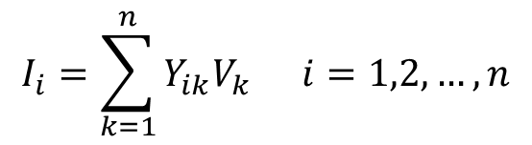
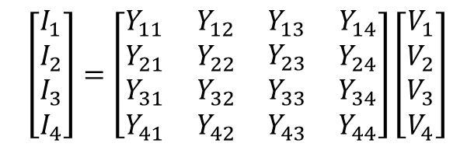

The Network Formulation Cont.
$$\left[\begin{matrix}I_{1} \\ I_{2} \\ \begin{matrix}I_{3} \\ I_{4}\end{matrix}\end{matrix}\right]=\left[\begin{matrix}Y_{11} \\ Y_{21} \\ \begin{matrix}Y_{31} \\ Y_{41}\end{matrix}\end{matrix} \begin{matrix}Y_{12} \\ Y_{22} \\ \begin{matrix}Y_{32} \\ Y_{42}\end{matrix}\end{matrix} \begin{matrix}Y_{13} \\ Y_{23} \\ \begin{matrix}Y_{33} \\ Y_{43}\end{matrix}\end{matrix} \begin{matrix}Y_{14} \\ Y_{24} \\ \begin{matrix}Y_{34} \\ Y_{44}\end{matrix}\end{matrix}\right]\left[\begin{matrix}V_{1} \\ V_{2} \\ \begin{matrix}V_{3} \\ V_{4}\end{matrix}\end{matrix}\right]$$
(8)
From index notation, Eq. (8) can be written in compact form as:
$$I_{i}=\sum_{k=1}^{n}{Y_{ik}V_{k}} i=1,2,…,n$$
(9)
or, in matrix form:
$$I_{BUS}=Y_{BUS}V_{BUS}$$
(10)
where Y_{BUS} denotes the matrix of bus admittance and is
known as bus admittance matrix.
The dimension of the Y_{BUS} matrix is (n × n) where n is the number of buses.
The total number of nodes are m = n + 1 including the ground (reference) node.

Slide 17

Powerflow Formulation
The complex power injected by the source into the ith bus of a power system is:
$$S_{i}=P_{i}+{jQ}_{i}=\left(P_{Gi}−P_{Di}\right)+j\left(Q_{Gi}−Q_{Di}\right)=V_{i}I_{i}^{∗} i=1,2,3,…,n$$
(11)
where V_{i} is the voltage at the $i$th bus with respect to ground and I_{i} is the source current injected into the bus.
As shown in (11), the power injections should equal the network flows.
The load flow problem is handled more conveniently by use of I_{i} rather than I_{i}*.

Slide 18

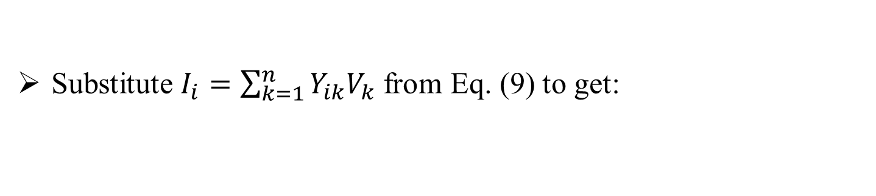
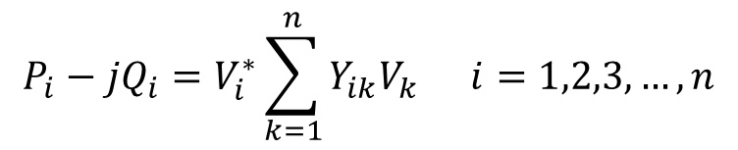
Powerflow Formulation Cont.
Therefore, taking the complex conjugate of Eq. (11) gives:
$$P_{i}−{jQ}_{i}=V_{i}^{∗}I_{i} i=1,2,3,…,n$$
(12)
Substitute $I_{i}=\sum_{k=1}^{n}{Y_{ik}V_{k}}$ from Eq. (9) to get:
$$P_{i}−{jQ}_{i}=V_{i}^{∗}\sum_{k=1}^{n}{Y_{ik}V_{k}} i=1,2,3,…,n$$
(13)

Slide 19

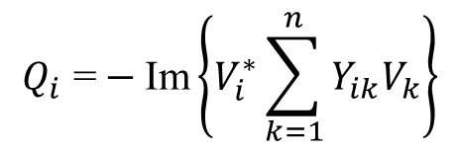
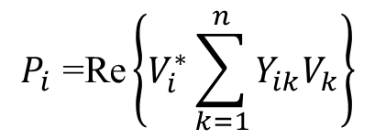
Powerflow Formulation Cont.
Equating real and imaginary parts:
$$P_{i}\text{ =}\text{Re}\left\{V_{i}^{∗}\sum_{k=1}^{n}{Y_{ik}V_{k}}\right\}$$
(14)
$$Q_{i}\text{ =}−\text{Im}\left\{V_{i}^{∗}\sum_{k=1}^{n}{Y_{ik}V_{k}}\right\}$$
(15)
In polar form:
$V_{i}=\left|V_{i}\right|e^{jδ_{i}}$
$Y_{ik}=\left|Y_{ik}\right|e^{{jθ}_{ik}}$
(16)

Slide 20


Powerflow Formulation Cont.
Real and reactive power flows between lines can be calculated:
$$P_{i}\text{ =}\left|V_{i}\right|\sum_{k=1}^{n}{\left|V_{k}\right|}Y_{ik}cos\left(θ_{i}−θ_{k}\right) i=1,2,…,n$$
(17)
$$Q_{i}\text{ =}−\left|V_{i}\right|\sum_{k=1}^{n}{\left|V_{k}\right|}Y_{ik}\sin\left(θ_{i}−θ_{k}\right){ i=1,2,…,n}$$
(18)
Because there are no energy storage elements, the complex power flows in (17) and (18) are equal to the power injections in (1)-(3).
By relating these equations, the fundamental power flow equations are derived.

Slide 21
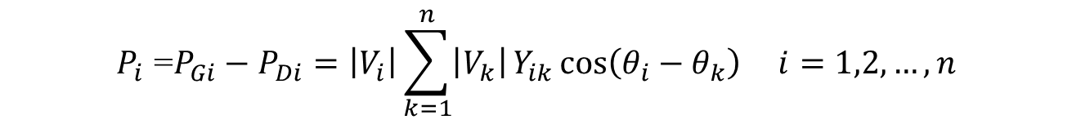
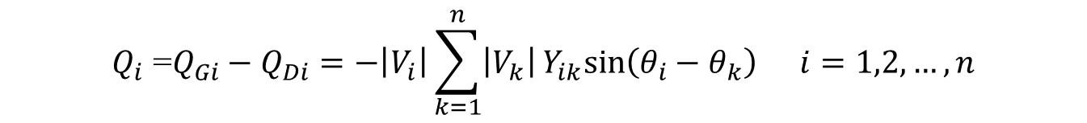
Powerflow Formulation Cont.
$$P_{i}\text{ =}P_{Gi}−P_{Di}=\left|V_{i}\right|\sum_{k=1}^{n}{\left|V_{k}\right|}Y_{ik}\cos\left(θ_{i}−θ_{k}\right) i=1,2,…,n$$
(19)
$$Q_{i}\text{ =}Q_{Gi}−Q_{Di}=−\left|V_{i}\right|\sum_{k=1}^{n}{\left|V_{k}\right|}Y_{ik}sin\left(θ_{i}−θ_{k}\right){ i=1,2,…,n}$$
(20)
Equations (19) and (20) represent 2n power flow equations at n buses of a power system (n real power flow equations and n reactive power flow equations).
Each bus is characterized by four variables; $P_{i}$, $Q_{i}$, $\left|V_{i}\right|$ and $δ_{i}$, resulting in a total of 4n variables.
Equations (19) and (20) can be solved for 2n variables if the remaining 2n variables are specified.

Slide 22
Powerflow Considerations
Practical considerations allow a power system analyst to fix a priori two variables at each bus.
The solution for the remaining 2n bus variables is obtained by iterative numerical techniques.
Depending upon which two variables are specified, the buses are classified into three categories – PQ Buses (Load Buses), PV Buses (Generator Buses), Slack or Reference Bus.
Slack bus (ref. bus) - Voltage magnitude and angle known : $\left|V_{i}\right|$, $δ_{\begin{aligned}i \\ \end{aligned}}$
PV Bus : real power and voltage magnitude known : $P_{i}$, $\left|V_{i}\right|$
PQ Bus : real and reactive powers known : $P_{i}$, $Q_{i}$

Slide 23



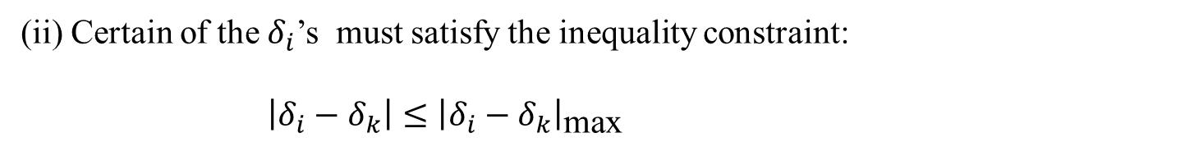
Powerflow Considerations
When we solve the power flow problem, all the variables must lie within practical limits.
Voltage magnitude $\left|V_{i}\right|$ must satisfy the inequality:
${\left|V_{i}\right|}_{\text{min}}≤\left|V_{i}\right|≤{\left|V_{i}\right|}_{\text{max}}$
(19)
(ii) Certain of the $δ_{i}$’s must satisfy the inequality constraint:
$\left|δ_{i}−δ_{k}\right|≤{\left|δ_{i}−δ_{k}\right|}_{\text{max}}$
(20)
(iii) Physical limitations on the generators, P_{Gi} and Q_{Gi} are constrained as follows:
$$P_{Gi, \text{min}}≤P_{Gi}≤P_{Gi, \text{max}}$$
(21)
$$Q_{Gi, \text{min}}≤Q_{Gi}≤Q_{Gi, \text{max}}$$
(22)

Slide 24
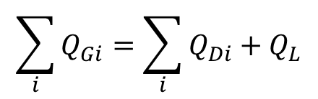
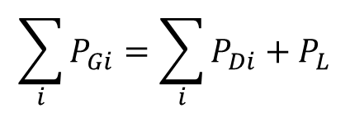
Powerflow Considerations
The total generation of real and reactive power must equal the total load demand plus losses, i.e.,
$$\sum_{i}{P_{Gi}}=\sum_{i}{P_{Di}+P_{L}}$$
(23)
$$\sum_{i}{Q_{Gi}}=\sum_{i}{Q_{Di}+Q_{L}}$$
(24)
where P_{L} and Q_{L} are system real and reactive power loss, respectively

Slide 25
Power Flow Solution Techniques
Once the non-linear power flow problem is properly formulated it is necessary to solve the equations.
Since the problem is highly non-linear and an analytic solution is not readily available, iterative solver are commonly used.
The following sections will examine some of the most common solution techniques.

Slide 26
Power Flow Solution Techniques
Review of balanced power flow
Gauss Iterative Technique
Gauss-Seidel Iterative Technique
Newton Raphson
Fast Decoupled
DC Power Flow

Slide 27
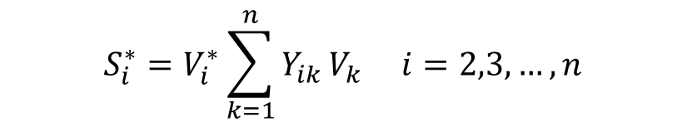
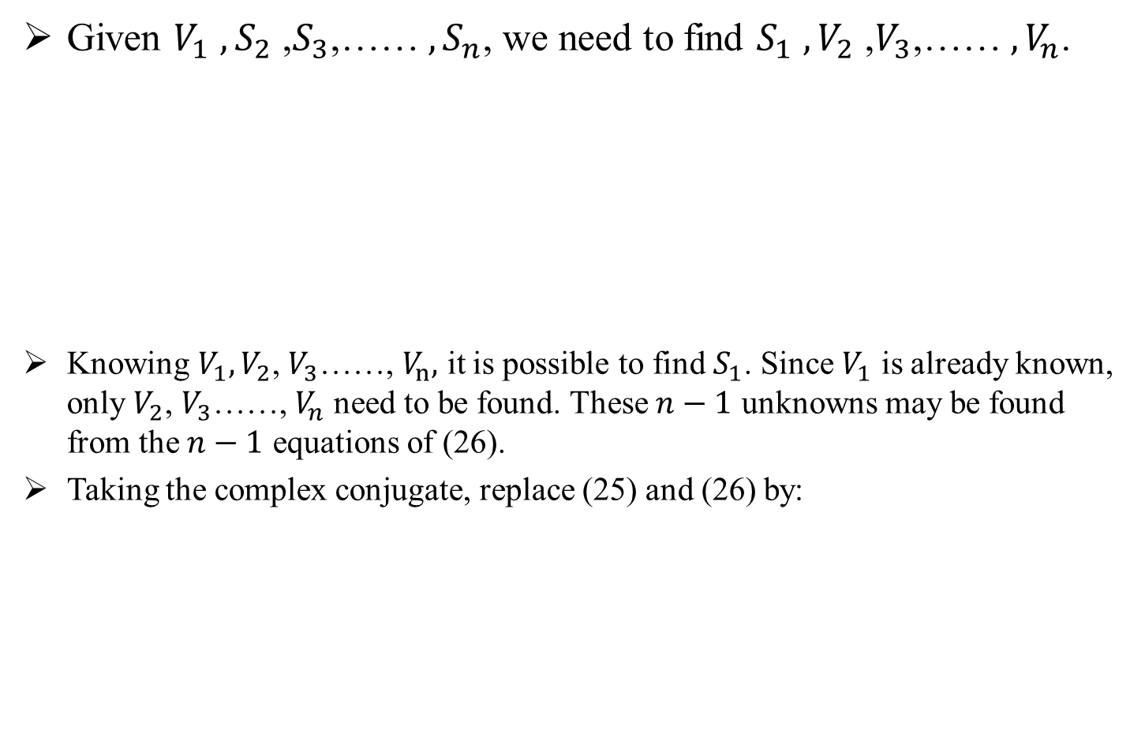
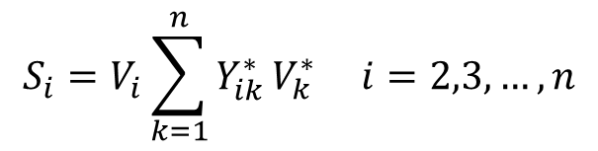

Gauss Iterative Technique
Given $V_{1}$ ${, S}_{2}$ ,$S_{3}$,…… ${, S}_{n}$, we need to find $S_{1}$ ${,V}_{2}$ ,$V_{3}$,…… ${, V}_{n}$.
Knowing $V_{1},V_{2}$, $V_{3}$……, $V_{n},$ it is possible to find $S_{1}$. Since $V_{1}$ is already known, only $V_{2}$, $V_{3}$……, $V_{n}$ need to be found. These $n−1$ unknowns may be found from the $n−1$ equations of (26).
Taking the complex conjugate, replace (25) and (26) by:
$$S_{1}=V_{1}\sum_{k=1}^{n}{Y_{1k}^{∗}}V_{k}^{∗}$$
(25)
$$S_{i}=V_{i}\sum_{k=1}^{n}{Y_{ik}^{∗}}V_{k}^{∗} i=2,3,…,n$$
(26)
$$S_{i}^{∗}=V_{i}^{∗}\sum_{k=1}^{n}{Y_{ik}}V_{k} i=2,3,…,n$$
(27)

Slide 28
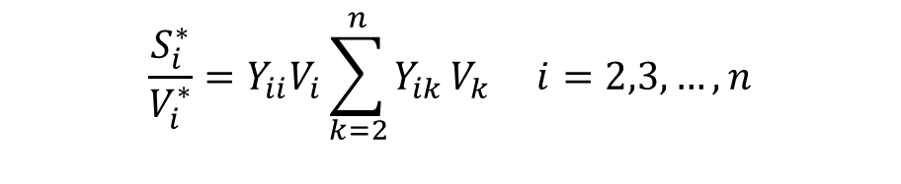

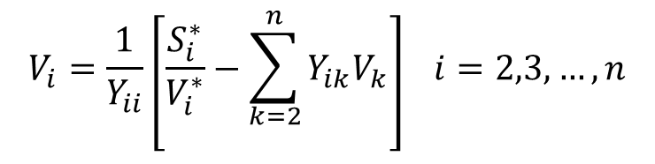
Gauss Iterative Technique
Dividing (27) by $V_{i}^{∗}$ and separating out the $Y_{ii}$ term, (27) can be rewritten as:
or, rearranging:
$$\frac{S_{i}^{∗}}{V_{i}^{∗}}=Y_{ii}V_{i}\sum_{\begin{matrix}k=2 \\ \end{matrix}}^{n}{Y_{ik}}V_{k} i=2,3,…,n$$
(28)
$$V_{i}=\frac{1}{Y_{ii}}\left[\frac{S_{i}^{∗}}{V_{i}^{∗}}−\sum_{\begin{matrix}k=2 \\ \end{matrix}}^{n}{Y_{ik}V_{k}}\right] i=2,3,…,n$$
(29)

Slide 29


Gauss Iterative Technique
Thus, we get $n−1$ implicit nonlinear algebraic equations in the unknown complex $V_{i}$ in the form:
where the ${\tilde{h}}_{i}$ are given by (29).
The numbering of (30) can be changed such that $x_{1}$=$V_{2}$, $x_{2}$=$V_{3, }…,x_{n}\text{=}V_{n}$.
$$V_{2}={\tilde{h}}_{2}\left(V_{2},V_{3},…,V_{n}\right)$$
$$V_{3}={\tilde{h}}_{3}\left(V_{2},V_{3},…,V_{n}\right)$$
$⋮$
$$V_{n}={\tilde{h}}_{n}(V_{2},V_{3},…,V_{n})$$
(30)

Slide 30
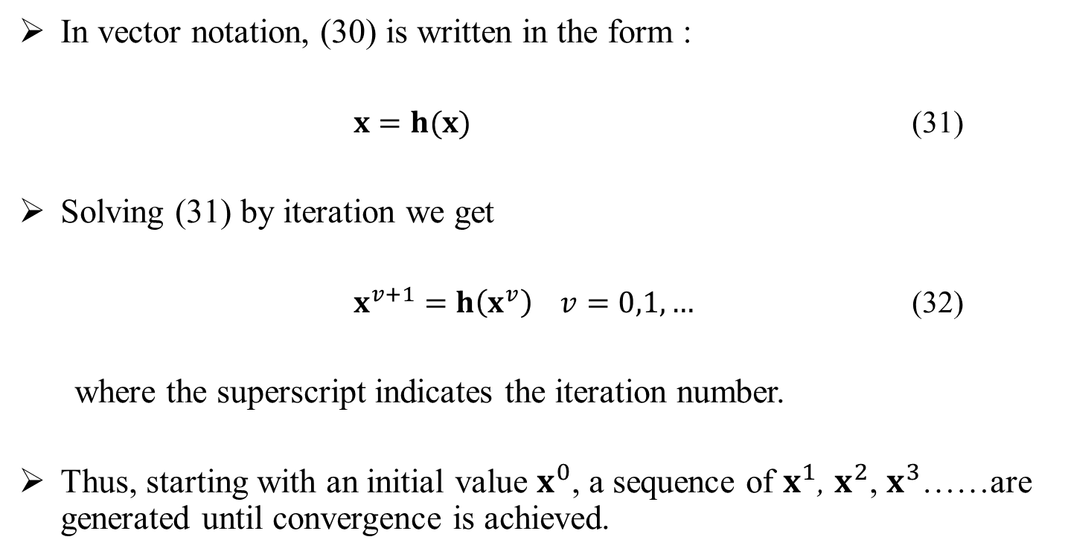
Gauss Iterative Technique
In vector notation, (30) is written in the form :
$x=h(x)$ (31)
Solving (31) by iteration we get
$x^{v+1}=h\left(x^{v}\right) v=0,1,…$ (32)
where the superscript indicates the iteration number.
Thus, starting with an initial value $x^{0}$, a sequence of $x^{1}$, $x^{2}$, $x^{3}$……are generated until convergence is achieved.

Slide 31

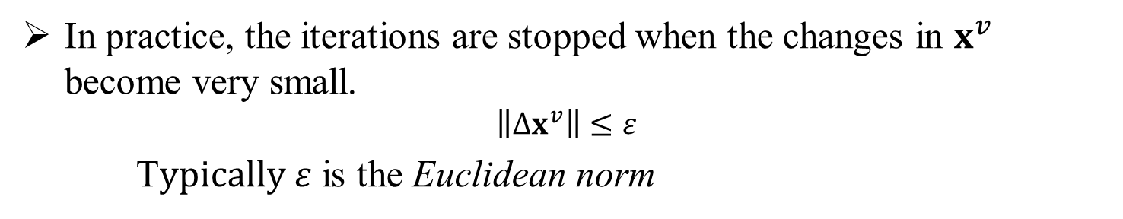
Gauss Iterative Technique
In practice, the iterations are stopped when the changes in $x^{v}$ become very small.
$$\left\|∆x^{v}\right\|≤ε$$
T$ypically ε$ is the Euclidean norm
Thus, Gauss iteration, v = 0,1,2,…..:
$$x_{1}^{v+1}=h_{1}\left(x_{1}^{v},x_{2}^{v},…,x_{N}^{v}\right)$$
$$x_{2}^{v+1}=h_{2}\left(x_{1}^{v},x_{2}^{v},…,x_{N}^{v}\right)$$
$⋮$
$$x_{N}^{v+1}=h_{N}(x_{1}^{v},x_{2}^{v},…,x_{N}^{v})$$
(33)

Slide 32
Power Flow Solution Techniques
Review of balanced power flow
Gauss Iterative Technique
Gauss-Seidel Iterative Technique
Newton Raphson
Fast Decoupled
DC Power Flow

Slide 33
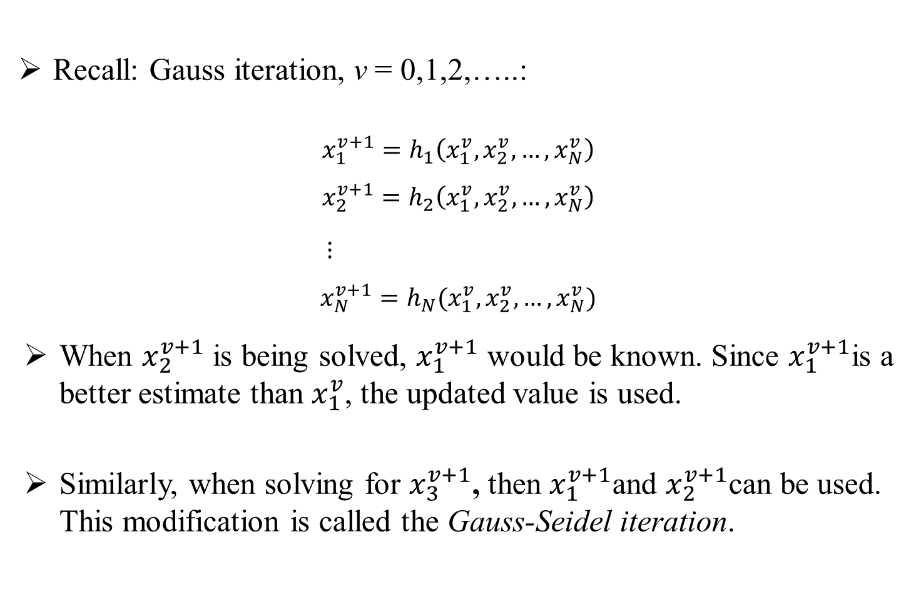
Gauss-Seidel Iterative Technique
Recall: Gauss iteration, v = 0,1,2,…..:
$$x_{1}^{v+1}=h_{1}\left(x_{1}^{v},x_{2}^{v},…,x_{N}^{v}\right)$$
$$x_{2}^{v+1}=h_{2}\left(x_{1}^{v},x_{2}^{v},…,x_{N}^{v}\right)$$
$⋮$
$$x_{N}^{v+1}=h_{N}(x_{1}^{v},x_{2}^{v},…,x_{N}^{v})$$
When $x_{2}^{v+1}$ is being solved, $x_{1}^{v+1}$ would be known. Since $x_{1}^{v+1}$is a better estimate than $x_{1}^{v}$, the updated value is used.
Similarly, when solving for $x_{3}^{v+1}$, then $x_{1}^{v+1}$and $x_{2}^{v+1}$can be used. This modification is called the Gauss-Seidel iteration.
(33)

Slide 34

Gauss-Seidel Iterative Technique
Gauss-Seidel iteration, v = 0,1,2,…..:
$x_{1}^{v+1}=h_{1}\left(x_{1}^{v},x_{2}^{v},…,x_{N}^{v}\right)$
$x_{2}^{v+1}=h_{2}\left(x_{1}^{v+1},x_{2}^{v},…,x_{N}^{v}\right)$
$x_{3}^{v+1}=h_{3}(x_{1}^{v+1},x_{2}^{v+1},x_{3}^{v}…,x_{N}^{v})$
$⋮$
$x_{N}^{v+1}=h_{N}(x_{1}^{v+1},x_{2}^{v+1},…,x_{N−1}^{v+1},x_{N}^{v})$
(34)

Slide 35
Power Flow Solution Techniques
Review of balanced power flow
Gauss Iterative Technique
Gauss-Seidel Iterative Technique
Newton Raphson
Fast Decoupled
DC Power Flow

Slide 36
Newton Raphson Method
Newton-Raphson Methods were originally developed for use on transmission level analysis.
They are based on the power injections at each node, both real and reactive.
These power injections are then used to update the voltage and voltage angle.
The NR method is a powerful method of solving a system of non-linear algebraic equations, requiring the calculation and inversion of a Jacobian matrix, which is computationally intensive.
It solves in a relatively few number of iterations.
It is the most widely used method for solving power flow problem.

Slide 37
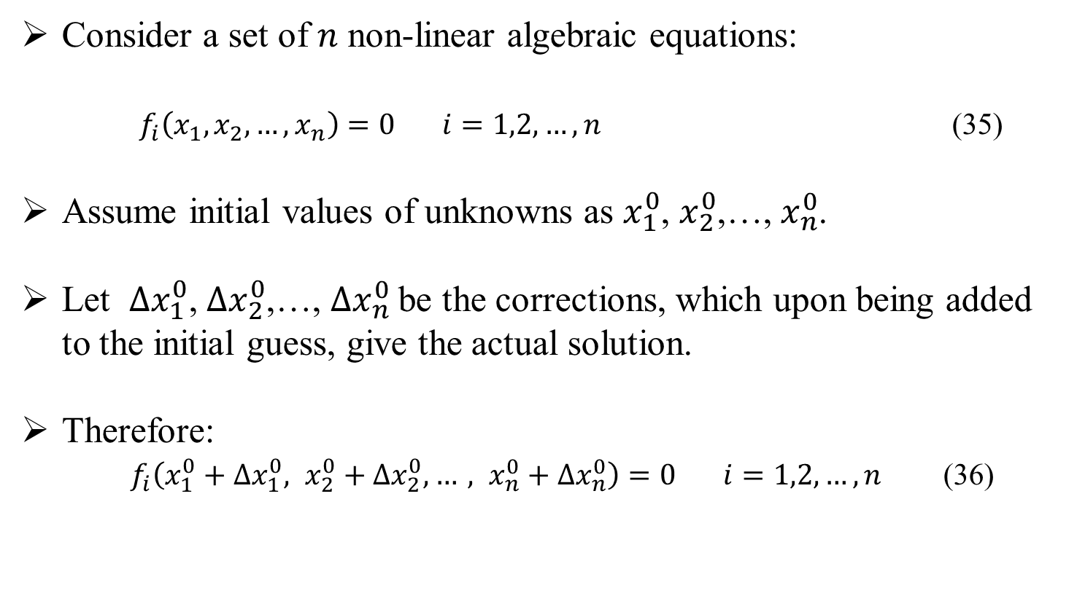
Newton Raphson General Form
Consider a set of $n$ non-linear algebraic equations:
$f_{i}\left(x_{1},x_{2},…,x_{n}\right)=0 i=1,2,…,n$ (35)
Assume initial values of unknowns as $x_{1}^{0}$, $x_{2}^{0}$,…, $x_{n}^{0}$.
Let ${∆x}_{1}^{0}$, ${∆x}_{2}^{0}$,…, ${∆x}_{n}^{0}$be the corrections, which upon being added to the initial guess, give the actual solution.
Therefore:
$f_{i}\left(x_{1}^{0}+{∆x}_{1}^{0}, x_{2}^{0}+{∆x}_{2}^{0},…, x_{n}^{0}+{∆x}_{n}^{0}\right)=0 i=1,2,…,n$ (36)

Slide 38

Newton Raphson General Form
Expanding these equations in Taylor series around the initial guess gives:
$$f_{i}\left(x_{1}^{0},x_{2}^{0},…,x_{n}^{0}\right)+\left[{\left(\frac{∂f_{i}}{∂x_{1}}\right)}^{0}∆x_{1}^{0}+⋯+{\left(\frac{∂f_{i}}{∂x_{n}}\right)}^{0}∆x_{n}^{0}\right]+higher order terms=0$$
(37)
where ${\left(\frac{∂f_{i}}{∂x_{1}}\right)}^{0}$, ${\left(\frac{∂f_{i}}{∂x_{2}}\right)}^{0},…{\left(\frac{∂f_{i}}{∂x_{n}}\right)}^{0}$are the derivatives of f_{i} with respect to x₁, x₂, …., x_{n} evaluated at $x_{1}^{0},x_{2}^{0},…,x_{n}^{0}$ .

Slide 39
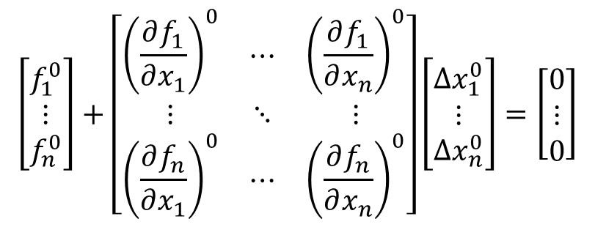
Newton Raphson General Form
$$f_{i}\left(x_{1}^{0},x_{2}^{0},…,x_{n}^{0}\right)+\left[{\left(\frac{∂f_{i}}{∂x_{1}}\right)}^{0}∆x_{1}^{0}+⋯+{\left(\frac{∂f_{i}}{∂x_{n}}\right)}^{0}∆x_{n}^{0}\right]+higher order terms=0$$
Neglecting higher order terms, write the above equation in matrix form.
$$\left[\begin{matrix}f_{1}^{0} \\ ⋮ \\ f_{n}^{0}\end{matrix}\right]+\left[\begin{matrix}{\left(\frac{∂f_{1}}{∂x_{1}}\right)}^{0} & ⋯ & {\left(\frac{∂f_{1}}{∂x_{n}}\right)}^{0} \\ ⋮ & ⋱ & ⋮ \\ {\left(\frac{∂f_{n}}{∂x_{1}}\right)}^{0} & ⋯ & {\left(\frac{∂f_{n}}{∂x_{n}}\right)}^{0}\end{matrix}\right]\left[\begin{matrix}{∆x}_{1}^{0} \\ ⋮ \\ {∆x}_{n}^{0}\end{matrix}\right]=\left[\begin{matrix}0 \\ ⋮ \\ 0\end{matrix}\right]$$
(38)

Slide 40

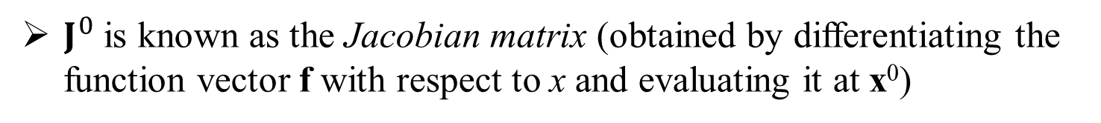

Newton Raphson General Form
Equation (38) can also be expressed as:
$$f^{0}+J^{0}{∆x}^{0}=0$$
(39)
$J^{0}$ is known as the Jacobian matrix (obtained by differentiating the function vector f with respect to x and evaluating it at x⁰)
Equation (39) can be rearranged:
$$f^{0}={−J}^{0}{∆x}^{0}$$
(40)

Slide 41
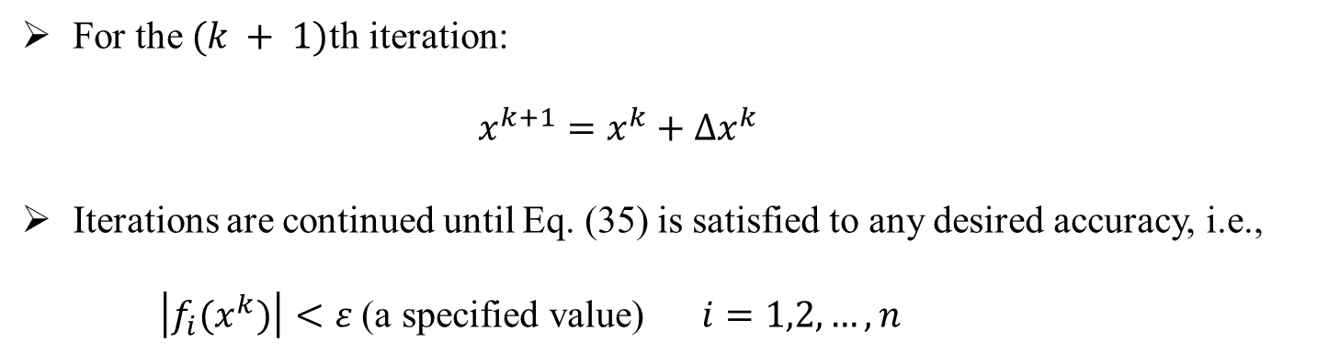
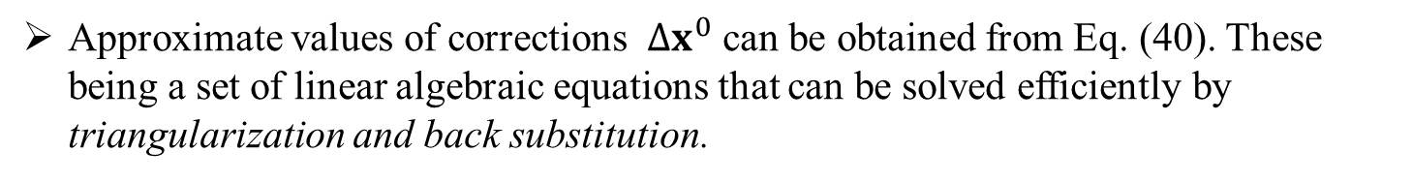

Newton Raphson General Form
$$x^{k+1}=x^{k}−{\left[J\left(x^{k}\right)\right]}^{−1}f\left(x^{k}\right)$$
(41)
Approximate values of corrections ${∆x}^{0}$ can be obtained from Eq. (40). These being a set of linear algebraic equations that can be solved efficiently by triangularization and back substitution.
For the $(k + 1)$th iteration:
$x^{k+1}=x^{k}+{∆x}^{k}$
Iterations are continued until Eq. (35) is satisfied to any desired accuracy, i.e.,
$\left|f_{i}(x^{k})\right|<ε \text{(}\text{a} \text{specified} \text{value}\text{)}$ $i=1,2,…,n$
(42)

Slide 42
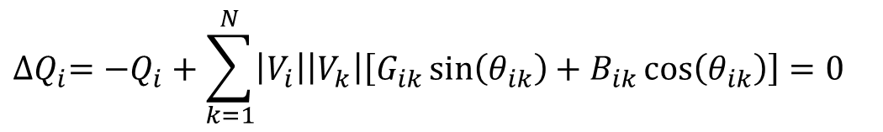
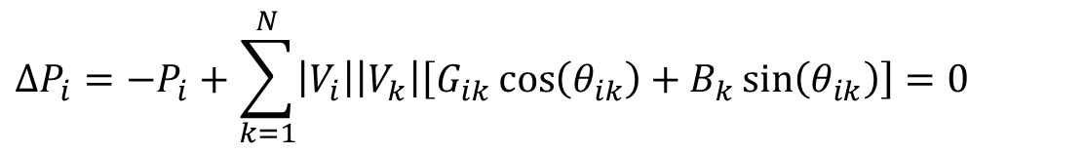
Newton Raphson For Power Systems
$$∆P_{i}=−P_{i}+\sum_{k=1}^{N}{\left|V_{i}\right|\left|V_{k}\right|\left[G_{ik}\cos\left(θ_{ik}\right)+B_{k}\sin\left(θ_{ik}\right)\right]}=0$$
$${∆Q}_{i}=−Q_{i}+\sum_{k=1}^{N}{\left|V_{i}\right|\left|V_{k}\right|\left[G_{ik}\sin\left(θ_{ik}\right)+B_{ik}\cos\left(θ_{ik}\right)\right]=0}$$
(43)

Slide 43
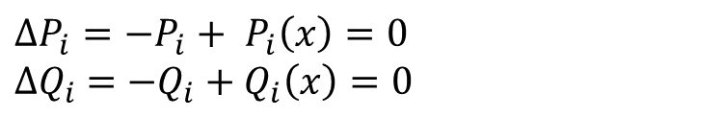
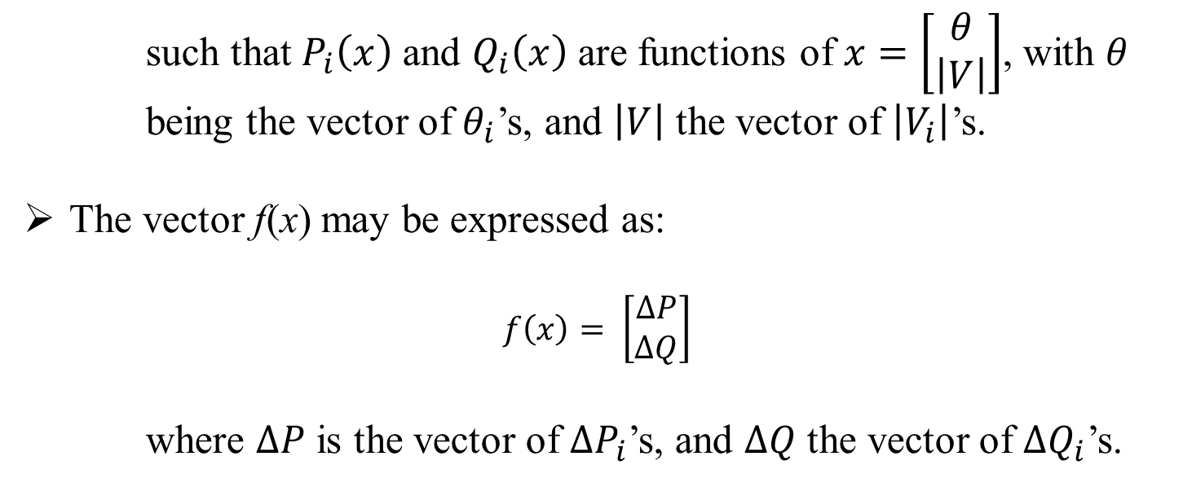
Newton Raphson For Power Systems
Consider the equations in (43) re-written:
$$∆P_{i}=−P_{i}+ P_{i}\left(x\right)=0$$
$${∆Q}_{i} =−Q_{i}+Q_{i}\left(x\right)=0$$
(44)
such that $P_{i}\left(x\right)$ and $Q_{i}\left(x\right)$ are functions of $x=\left[\begin{matrix}θ \\ \left|V\right|\end{matrix}\right]$, with $θ$
being the vector of $θ_{i}$’s, and $\left|V\right|$ the vector of $\left|V_{i}\right|$’s.
The vector f(x) may be expressed as:
$$f\left(x\right)= \left[\begin{matrix}∆P \\ ∆Q\end{matrix}\right]$$
where $∆P$ is the vector of $∆P_{i}$’s, and $∆Q$ the vector of ${∆Q}_{i}$’s.

Slide 44

Newton Raphson For Power Systems
From equation (40):
$f=−J ∆x$
$$\left[\begin{matrix}∆P \\ ∆Q\end{matrix}\right]=−\left[J\right]\left[\begin{matrix}∆θ \\ ∆\left|V\right|\end{matrix}\right]$$
$$\left[\begin{matrix}∆θ \\ ∆\left|V\right|\end{matrix}\right]={−\left[J\right]}^{−1}\left[\begin{matrix}∆P \\ ∆Q\end{matrix}\right]$$
$${\left[\begin{matrix}θ \\ \left|V\right|\end{matrix}\right]}_{k+1}={\left[\begin{matrix}θ \\ \left|V\right|\end{matrix}\right]}_{k}−{\left[J\right]}_{k}^{−1}{\left[\begin{matrix}∆P \\ ∆Q\end{matrix}\right]}_{k}$$
(45)
Equation (45) shows how the state variable can be solved for each iteration.
The number of iterations depends on the desired accuracy.

Slide 45
Worked Powerflow Examples
Gauss Siedel
Newton Raphson

Slide 46
Gauss-Seidel Worked Example
The figure below shows a single-line diagram of a five-bus power system. The four tables on the following slides contain input data.

Slide 47
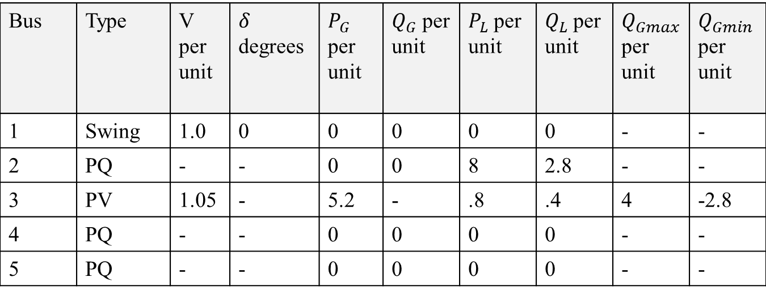
Bus input Data
Bus | Type | V per unit | $δ$ degrees | $P_{G}$ per unit | $Q_{G}$ per unit | $P_{L}$ per unit | $Q_{L}$ per unit | $Q_{Gmax}$ per unit | $Q_{Gmin}$ per unit
1 | Swing | 1.0 | 0 | 0 | 0 | 0 | 0 | - | -
2 | PQ | - | - | 0 | 0 | 8 | 2.8 | - | -
3 | PV | 1.05 | - | 5.2 | - | .8 | .4 | 4 | -2.8
4 | PQ | - | - | 0 | 0 | 0 | 0 | - | -
5 | PQ | - | - | 0 | 0 | 0 | 0 | - | -
Bus 1 has a generator connected and is a swing bus.
Bus 3 has a generator and a load connected. It is a voltage controlled bus.
Buses 2,3, and 5 are all load buses.

Slide 48
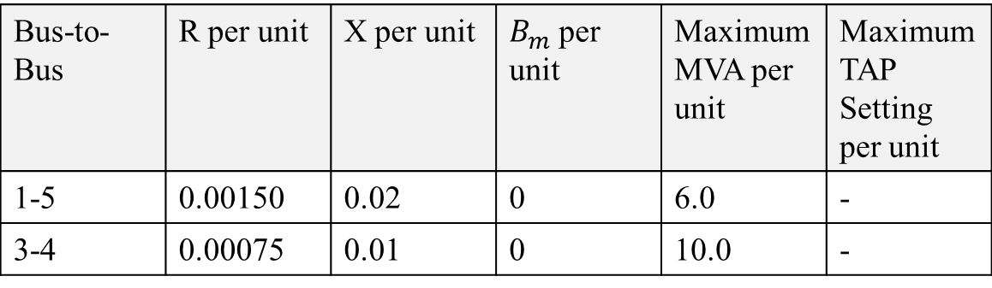
Line input Data
Bus-to-Bus | R’ per unit | X’ per unit | B’ per unit | Maximum MVA per unit
2-4 | 0.0090 | 0.100 | 1.72 | 12.0
2-5 | 0.0045 | 0.050 | 0.88 | 12.0
4-5 | 0.00225 | 0.025 | 0.44 | 12.0
Transformer input Data
Bus-to-Bus | R per unit | X per unit | $B_{m}$ per unit | Maximum MVA per unit | Maximum TAP Setting per unit
1-5 | 0.00150 | 0.02 | 0 | 6.0 | -
3-4 | 0.00075 | 0.01 | 0 | 10.0 | -

Slide 49
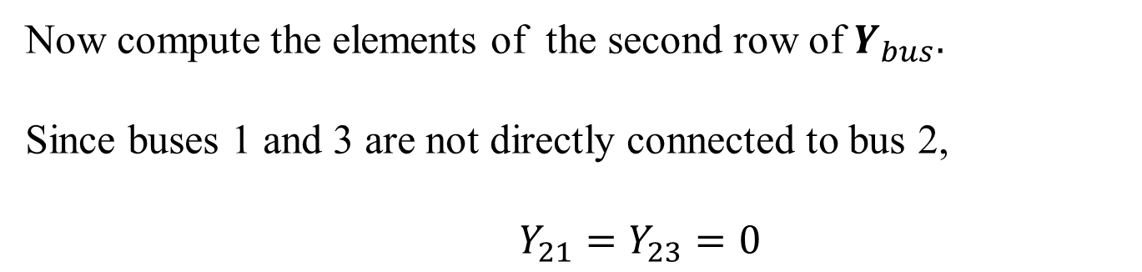
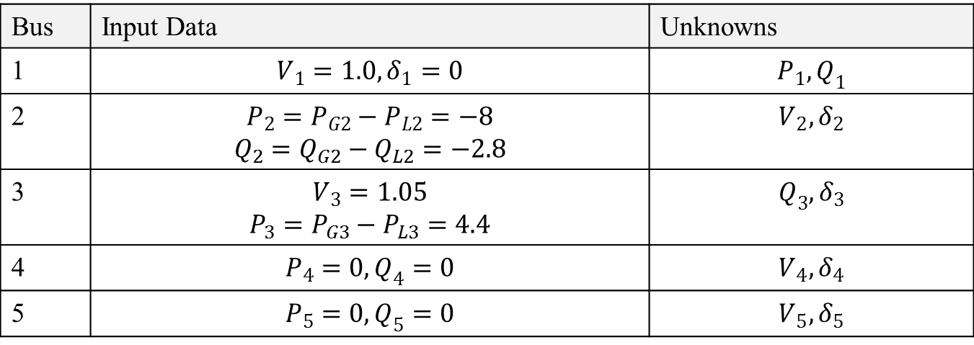
Input Data and Unknowns
Bus | Input Data | Unknowns
1 | $$V_{1}=1.0, δ_{1}=0$$ | $$P_{1},Q_{1}$$
2 | $$P_{2}=P_{G2}−P_{L2}=−8$$ $$Q_{2}=Q_{G2}−Q_{L2}=−2.8$$ | $$V_{2},δ_{2}$$
3 | $$V_{3}=1.05$$ $$P_{3}=P_{G3}−P_{L3}=4.4$$ | $$Q_{3},δ_{3}$$
4 | $$P_{4}=0, Q_{4}=0$$ | $$V_{4},δ_{4}$$
5 | $$P_{5}=0, Q_{5}=0$$ | $$V_{5},δ_{5}$$
Now compute the elements of the second row of $Y_{bus}.$
Since buses 1 and 3 are not directly connected to bus 2,
$Y_{21}=Y_{23}=0$

Slide 50
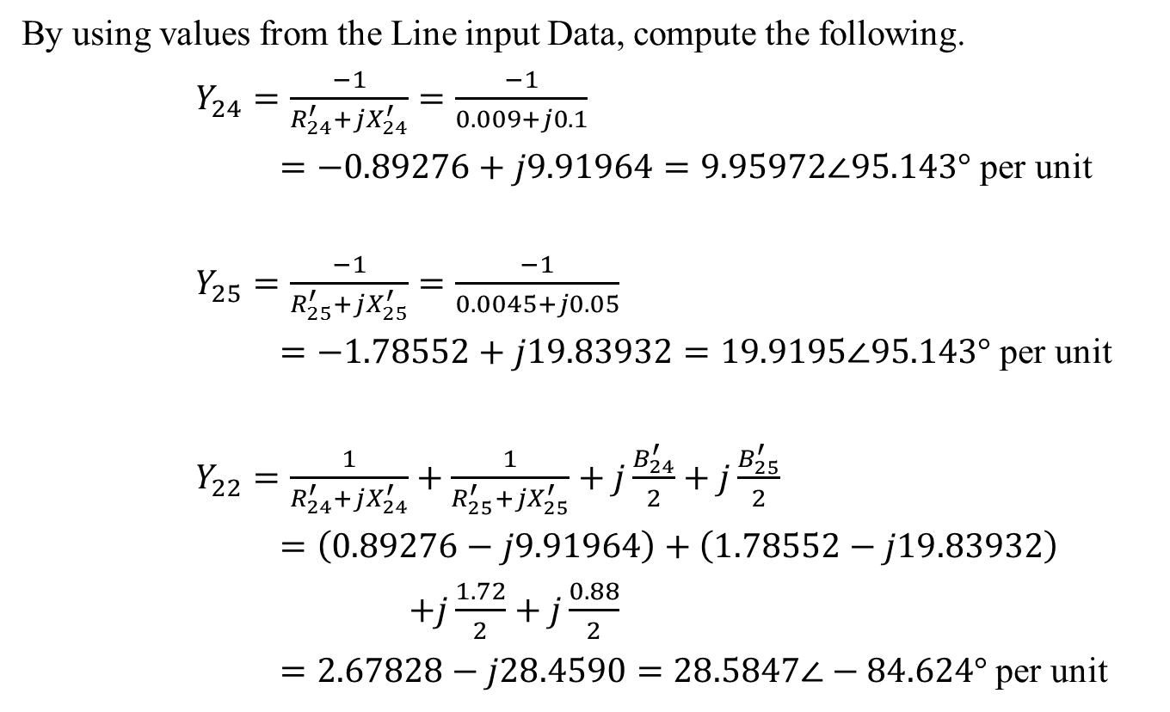
Gauss-Seidel Worked Example
By using values from the Line input Data, compute the following.
$Y_{24}=\frac{−1}{R_{24}^{′}+jX_{24}^{′}}=\frac{−1}{0.009+j0.1}$
$=−0.89276+j9.91964=9.95972∠95.143°$ per unit
$Y_{25}=\frac{−1}{R_{25}^{′}+jX_{25}^{′}}=\frac{−1}{0.0045+j0.05}$
$=−1.78552+j19.83932=19.9195∠95.143°$ per unit
$Y_{22}=\frac{1}{R_{24}^{′}+jX_{24}^{′}}+\frac{1}{R_{25}^{′}+jX_{25}^{′}}+j\frac{B_{24}^{′}}{2}+j\frac{B_{25}^{′}}{2}$
$=\left(0.89276−j9.91964\right)+\left(1.78552−j19.83932\right)$
$+j\frac{1.72}{2}+j\frac{0.88}{2}$
$=2.67828−j28.4590=28.5847∠−84.624°$ per unit

Slide 51
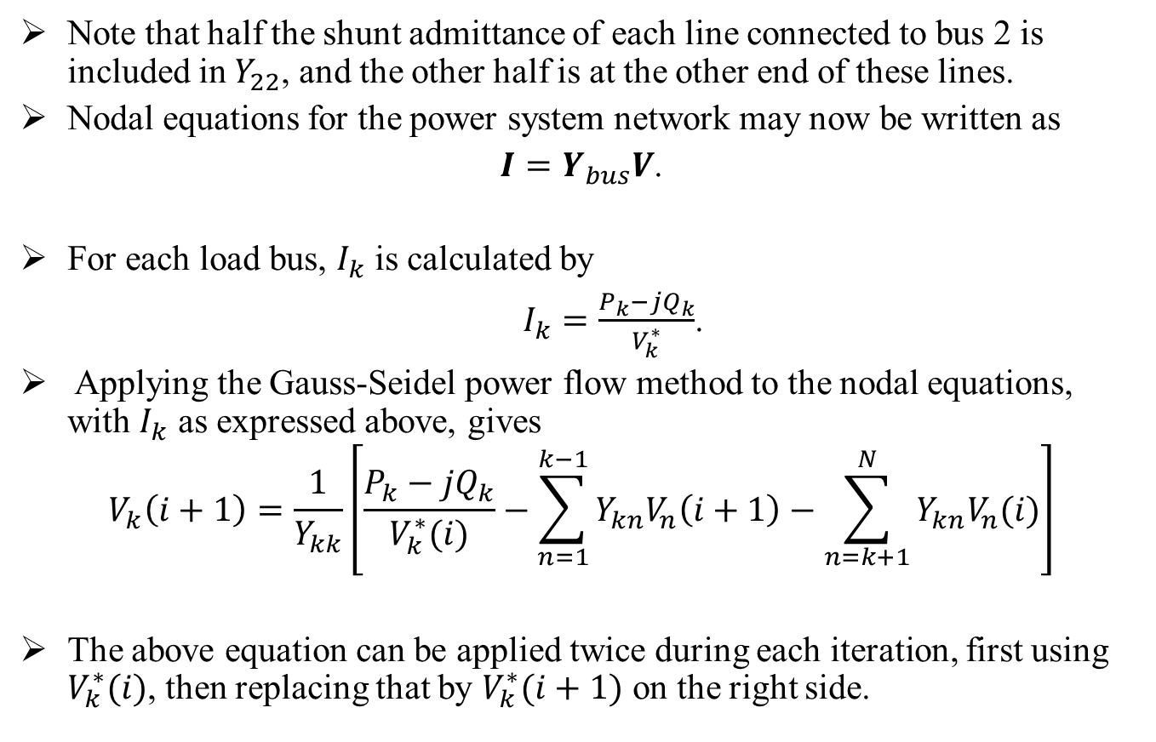
Gauss-Seidel Worked Example Cont.
Note that half the shunt admittance of each line connected to bus 2 is included in $Y_{22}$, and the other half is at the other end of these lines.
Nodal equations for the power system network may now be written as
$I=Y_{bus}V$.
For each load bus, $I_{k}$ is calculated by
$I_{k}=\frac{P_{k}−jQ_{k}}{V_{k}^{∗}}$.
Applying the Gauss-Seidel power flow method to the nodal equations, with $I_{k}$ as expressed above, gives
$$V_{k}\left(i+1\right)=\frac{1}{Y_{kk}}\left[\frac{P_{k}−{jQ}_{k}}{V_{k}^{∗}(i)}−\sum_{n=1}^{k−1}{Y_{kn}V_{n}\left(i+1\right)}−\sum_{n=k+1}^{N}{Y_{kn}V_{n}(i)}\right]$$
The above equation can be applied twice during each iteration, first using $V_{k}^{∗}(i)$, then replacing that by $V_{k}^{∗}(i+1)$ on the right side.

Slide 52
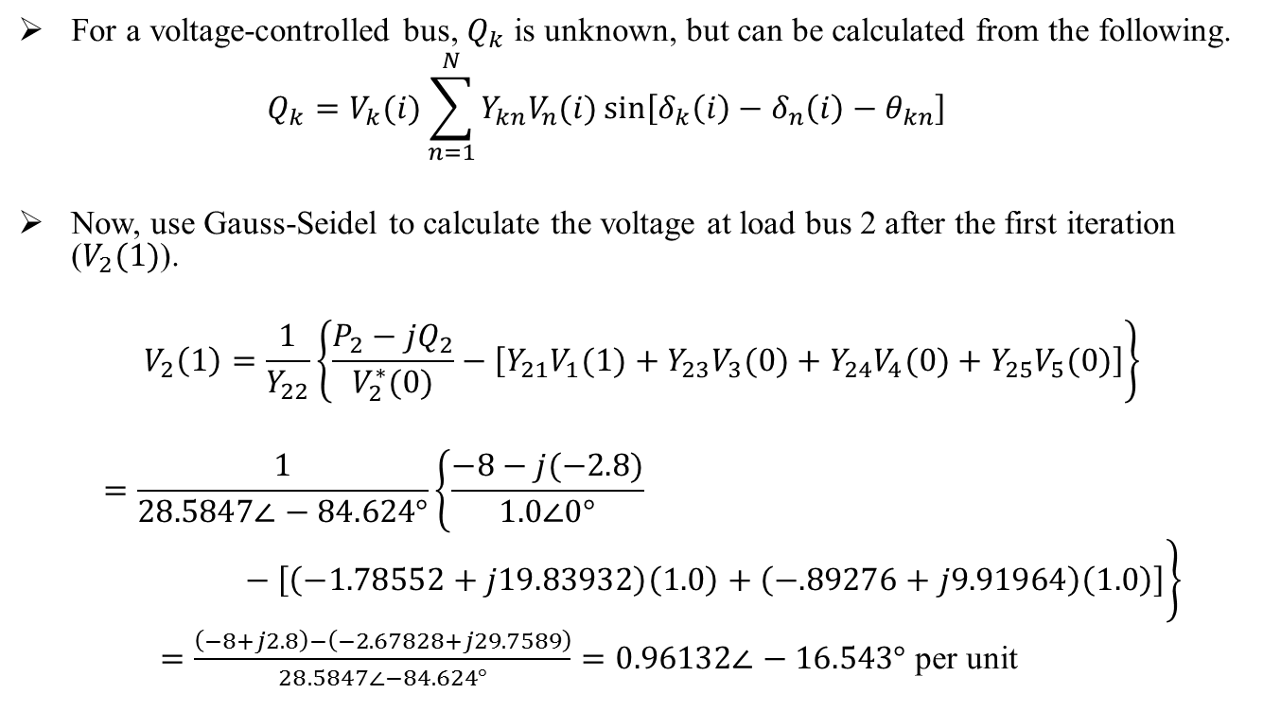
Gauss-Seidel Worked Example
For a voltage-controlled bus, $Q_{k}$ is unknown, but can be calculated from the following.
$$Q_{k}=V_{k}(i)\sum_{n=1}^{N}{Y_{kn}V_{n}(i)\sin\left[δ_{k}\left(i\right)−δ_{n}\left(i\right)−θ_{kn}\right]}$$
Now, use Gauss-Seidel to calculate the voltage at load bus 2 after the first iteration ($V_{2}(1)$).
$$V_{2}\left(1\right)=\frac{1}{Y_{22}}\left\{\frac{P_{2}−{jQ}_{2}}{V_{2}^{∗}(0)}−\left[Y_{21}V_{1}(1)+Y_{23}V_{3}(0)+Y_{24}V_{4}(0)+Y_{25}V_{5}(0)\right]\right\}$$
$$=\frac{1}{28.5847∠−84.624°}\left\{\frac{−8−j(−2.8)}{1.0∠0°}−\left[\left(−1.78552+j19.83932\right)\left(1.0\right)+\left(−.89276+j9.91964\right)\left(1.0\right)\right]\right\}$$
$=\frac{\left(−8+j2.8\right)−\left(−2.67828+j29.7589\right)}{28.5847∠−84.624°}=0.96132∠−16.543°$ per unit

Slide 53
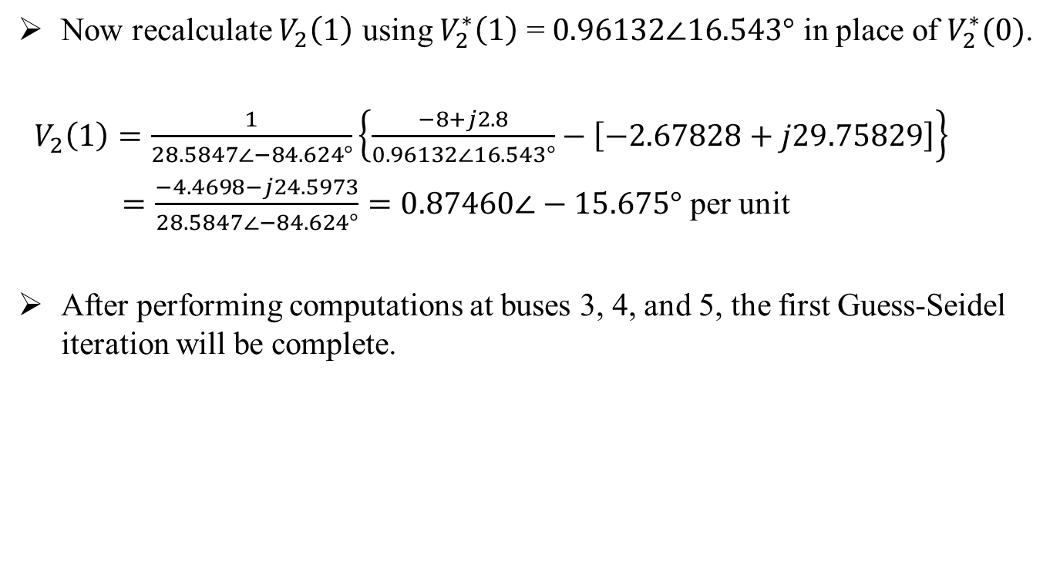
Gauss-Seidel Worked Example
Now recalculate $V_{2}\left(1\right)$ using $V_{2}^{∗}\left(1\right)$ = $0.96132∠16.543°$ in place of $V_{2}^{∗}(0)$.
$V_{2}\left(1\right)=\frac{1}{28.5847∠−84.624°}\left\{\frac{−8+j2.8}{0.96132∠16.543°}−\left[−2.67828+j29.75829\right]\right\}$
$=\frac{−4.4698−j24.5973}{28.5847∠−84.624°}=0.87460∠−15.675°$ per unit
After performing computations at buses 3, 4, and 5, the first Guess-Seidel iteration will be complete.

Slide 54
Newton Raphson Worked Example
This is a transmission level system.
3 nodes
2 generators
1 load
The transmission lines are assumed to be purely inductive, with no resistance.
Node types:
Node1 :Swing bus
Node 2: PV bus
Node 3: PQ bus

Slide 55
Newton Raphson Worked Example
(46)
(47)
(48)

Slide 56
Newton Raphson Worked Example
(49)
(50)

Slide 57
Newton Raphson Worked Example

Slide 58
Part 1 - Review of balanced power flow
Review of balanced power flow
Gauss Iterative Technique
Gauss-Seidel Iterative Technique
Newton Raphson
Fast Decoupled
DC Power Flow

Slide 59
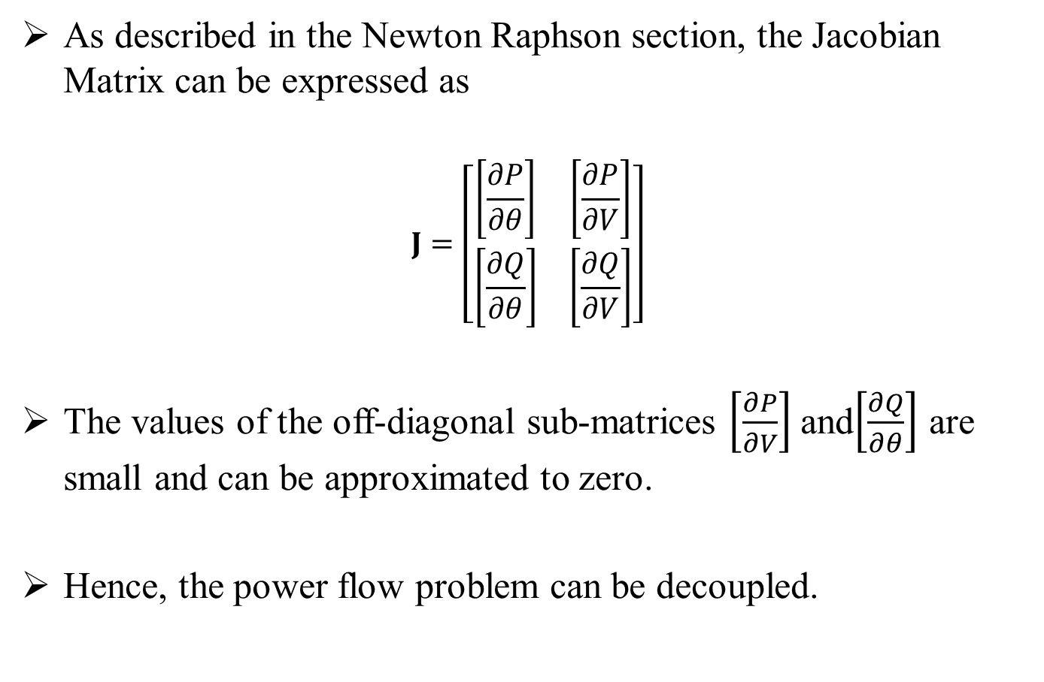
Fast Decoupled Power Flow
As described in the Newton Raphson section, the Jacobian Matrix can be expressed as
$$J=\left[\begin{matrix}\left[\frac{∂P}{∂θ}\right] & \left[\frac{∂P}{∂V}\right] \\ \left[\frac{∂Q}{∂θ}\right] & \left[\frac{∂Q}{∂V}\right]\end{matrix}\right]$$
The values of the off-diagonal sub-matrices $\left[\frac{∂P}{∂V}\right]$ and$\left[\frac{∂Q}{∂θ}\right]$ are small and can be approximated to zero.
Hence, the power flow problem can be decoupled.
(51)

Slide 60

Fast Decoupled Power Flow
Substitute approximations into Eq. (48).
$\left[\begin{matrix}\left[\frac{∂P}{∂θ}\right] & \left[0\right] \\ \left[0\right] & \left[\frac{∂Q}{δ∂V}\right]\end{matrix}\right]\left[\begin{matrix}∆θ \\ ∆V\end{matrix}\right]=\left[\begin{matrix}∆P \\ ∆Q\end{matrix}\right]$
Then,
$$\left[\frac{∂P}{∂θ}\right]\left[∆θ\right]= \left[∆P\right]$$
$$\left[\frac{∂Q}{∂V}\right]\left[∆V\right]=\left[∆Q\right]$$
(52)

Slide 61
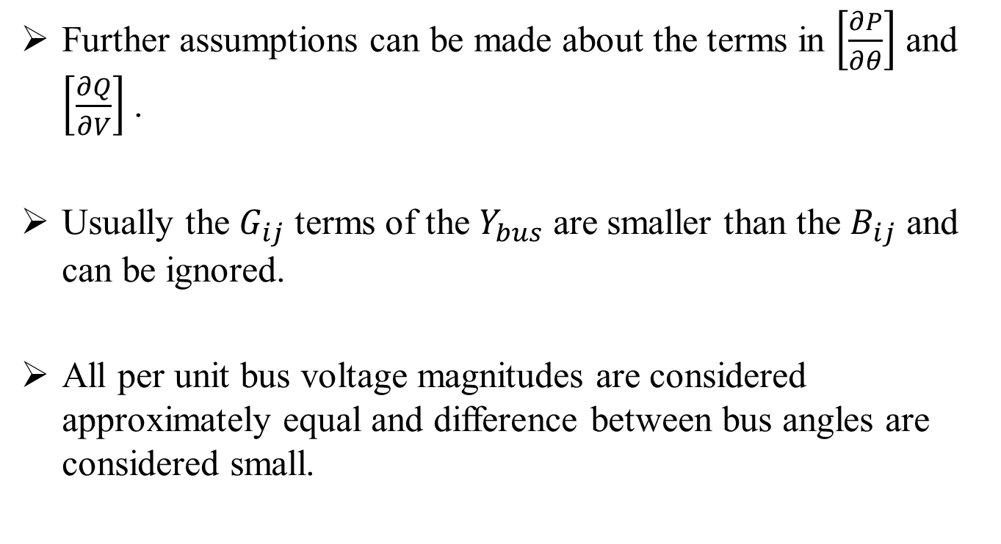
Fast Decoupled Power Flow
Further assumptions can be made about the terms in $\left[\frac{∂P}{∂θ}\right]$ and $\left[\frac{∂Q}{∂V}\right]$ .
Usually the $G_{ij}$ terms of the $Y_{bus}$ are smaller than the $B_{ij}$ and can be ignored.
All per unit bus voltage magnitudes are considered approximately equal and difference between bus angles are considered small.

Slide 62

Fast Decoupled Power Flow
Then, the diagonal terms of $\left[\frac{∂P}{∂θ}\right]$ and $\left[\frac{∂Q}{∂V}\right]$ can be written as:
$\frac{∂P_{i}}{∂θ_{i}}=−Q_{i}−B_{ii}{\left|V_{i}\right|}^{2}≈\sum_{k=1}^{n}{\left|V_{i}\right|\left|V_{k}\right|B_{ik}−{\left|V_{i}\right|}^{2}B_{ii}≈−{\left|V_{i}\right|}^{2}B_{ii}}$ (53)
$\frac{∂Q_{i}}{∂\left|V_{i}\right|}=\frac{Q_{i}}{\left|V_{i}\right|}−B_{ii}\left|V_{i}\right|≈−\sum_{k=1}^{n}{\left|V_{k}\right|B_{ik}}−\left|V_{i}\right|B_{ii}≈−\left|V_{i}\right|B_{ii}$ (54)

Slide 63

Fast Decoupled Power Flow
The off-diagonal terms of $\left[\frac{∂P}{∂θ}\right]$ and $\left[\frac{∂Q}{∂V}\right]$ can be written as:
$\frac{∂P_{i}}{∂θ_{j}}=\left|V_{i}\right|\left|V_{j}\right|\left(G_{ij}\sin{θ_{ij}−B_{ij}\cos{θ_{ij}}}\right)≈−\left|V_{i}\right|\left|V_{j}\right|B_{ij}$
$\frac{∂Q_{i}}{ ∂\left|V_{j}\right|}=\left|V_{i}\right|\left(G_{ij}\sin{θ_{ij}−B_{ij}\cos{θ_{ij}}}\right)≈−\left|V_{i}\right|B_{ij}$ (55)

Slide 64

Fast Decoupled Power Flow
Consider $\left[V\right]≜\left[\begin{matrix}\left|V_{2}\right| & ⋯ & 0 \\ ⋮ & ⋱ & ⋮ \\ 0 & ⋯ & \left|V_{n}\right|\end{matrix}\right]$ and $B≜\left[\begin{matrix}B_{22} \\ ⋮ \\ B_{n2}\end{matrix} \begin{matrix}B_{23} \\ ⋮ \\ B_{n3}\end{matrix} ⋯ \begin{matrix}B_{2n} \\ ⋮ \\ B_{nn}\end{matrix}\right]$,
where B may obtained from $Y_{bus}$ by stripping away the first row and column and then taking the imaginary part.
Then,
$$\left[\begin{matrix}∂P \\ ∂θ\end{matrix}\right]=−\left[V\right]B\left[V\right]$$
$$\left[\begin{matrix}∂Q \\ ∂V\end{matrix}\right]=−\left[V\right]B$$
(56)

Slide 65

Fast Decoupled Power Flow
Substitute into equation (52) to get
$$−\left[V\right]B\left[V\right]\left[∆θ\right]= \left[∆P\right]$$
$$−\left[V\right]B\left[∆V\right]=\left[∆Q\right]$$
Because of the assumption that all per unit $\left|V_{i}\right|$ are equal, assume the second $\left[V\right]$ in (57) is the identity matrix.
Thus
$$−B\left[∆θ\right]={\left[V\right]}^{−1}\left[∆P\right]=\left[∆\tilde{P}\right]$$
$−B\left[∆V\right]={\left[V\right]}^{−1}\left[∆Q\right]=\left[∆\tilde{Q}\right]$
Note that $\left[∆\tilde{P}\right]$ and $\left[∆\tilde{Q}\right]$ are just scaled versions of $\left[∆P\right]$ and $\left[∆Q\right]$.
(57)
(58)

Slide 66
Fast Decoupled Power Flow
An important observation is that B is a constant matrix, independent of iteration count. Thus, only one matrix inversion of B is required.
These equations are known as the fast-decoupled power flow equations and this is most commonly used as the power flow solver in commercial packages.

Slide 67
Part 1 - Review of balanced power flow
Review of balanced power flow
Gauss Iterative Technique
Gauss-Seidel Iterative Technique
Newton Raphson
Fast Decoupled
DC Power Flow

Slide 68

DC Power Flow
DC powerflow is a non-iterative solution because of various assumptions.
Reactive power flows are ignored.
All node voltages are assumed to be 1 per unit.
The entire problem reduced to a single set of linear equations:
$θ=B^{−1}$P
The name DC Power Flow is derived from the fact that the equations are linear and the solution of the equations is real power.
DC Power Flow is used in Optimal Power Flow (OPF) solvers, Location Marginal Price (LMP) solvers, and Contingency Analysis (CA).

Slide 69
Part 2 - Forward Backward Sweep (FBS) Method
At the distribution level the assumption of a three phase balanced system is not longer appropriate.
For distribution feeders which are generally operated in a radial configuration, the FBS method is an effective unbalanced power flow solution method.
The FBS method will not work for a looped or meshed system.

Slide 70
Forward Backward Sweep (FBS) Method
The ‘Forward’ sweep computes the voltage at node 5 under no-load condition.
With no load currents, there are no line currents.
Thus the node 5 voltage will equal that of the specified source voltage.
The ‘Backward’ sweep commences by computing the load current at node 5.

Slide 71

Forward Backward Sweep (FBS) Method
The load current at each node is computed by:
$I_{n}={\left(\frac{S_{n}}{V_{n}}\right)}^{∗}$ (59)
The backward sweep will determine a computed source voltage $V_{1}$.
However, the first iteration will produce a voltage that is not equal to the specified source voltage $V_{s}$.
Because the system is non-linear, the solution must be found by again doing an iteration of the ‘Forward’ sweep.

Slide 72

Forward Backward Sweep (FBS) Method
The ‘Forward’ sweep is conducted with the specified source voltage and the line currents from the previous backward sweep.
Using KVL for the line between node 1 and node 2 gives:
$V_{2}=V_{s}−Z_{12}∙I_{12}$ (60)
This procedure is repeated for each line segment until a “new” voltage is determined at node 5.
Using the new voltage a backward sweep is started that will lead to a new source current.

Slide 73


FBS Example
Infinite
Bus
2000
'
3500
'
[
[
Z
]
Z
12
]
I
23
I
12
23
I
I
load
3
1
2
load
2
3
S
load
S
load
2
3
Nominal Voltage: $2400$ V
The following matrix is the standard impedance matrix from the IEEE 4 node test feeder.
$Z_{base}=\left[\begin{matrix}0.4013+j1.4133 & 0.0953+j0.8515 & 0.0953+j0.7266 \\ 0.0953+j0.8515 & 0.413+j1.4133 & 0.0953+j0.7802 \\ 0.0953+j0.7266 & 0.0953+j0.7802 & 0.4013+j1.4133\end{matrix}\right]$ $\frac{Ω}{\text{mile}}$

Slide 74


FBS Example
Using $Z_{base}$, $Z_{12}$ and $Z_{23}$ may be computed.
$Z_{12}=Z_{base}∙\frac{{2000}^{′}}{{5280}^{′}}=\left[\begin{matrix}0.1520+j0.5353 & 0.0361+j0.3225 & 0.0361+j0.2752 \\ 0.0361+j0.3225 & 0.1520+j0.5353 & 0.0361+j0.2955 \\ 0.0361+j0.2752 & 0.0361+j0.2955 & 0.1520+j0.5353\end{matrix}\right]$ $Ω$
$Z_{23}=Z_{base}∙\frac{3500′}{5280′}=\left[\begin{matrix}0.2660+j0.9368 & 0.0632+j0.5644 & 0.0632+j0.4816 \\ 0.0632+j0.5644 & 0.2660+j0.9368 & 0.0632+j0.5172 \\ 0.0632+j0.4816 & 0.0632+j0.5172 & 0.2660+j0.9368\end{matrix}\right]$ $Ω$

Slide 75

FBS Example
Initial voltages are set up as follows.
$V_{1}=\left[\begin{matrix}2400 ∠ 0° \\ 2400 ∠−120° \\ 2400 ∠ 120°\end{matrix}\right]$ V
On the first pass, all nodes start at nominal.
Therefore,
$$V_{1}=V_{2}^{1}=V_{3}^{1}$$
$S_{{load}_{2}}$ and $S_{{load}_{3}}$ are defined.
$S_{{load}_{2}}=\left[\begin{matrix}0 \\ 75+j30 \\ 0\end{matrix}\right]$kVA
$S_{{load}_{3}}=\left[\begin{matrix}127.5+j80 \\ 110+j75 \\ 13+j10\end{matrix}\right]$kVA

Slide 76
FBS Example
Equations to be used:
Recall that current injection is calculated by
Also, the following standard circuit analysis equations will be used.
$I={\left(\frac{S}{V}\right)}^{∗}$.
$$V_{out}=(a)V_{in}−(b)I_{line}$$
$${ I}_{in}=(c)V_{out}+(d)I_{out}$$
Assume:
$a=d=identity$
$b=Z$
$c=0$
From circuit representations of distribution lines, $I_{out}$ = $I_{line}$
Therefore, the resulting equations are as follows.
$V_{out}=V_{in}−\left(Z\right)I_{line}$
$I_{in}=I_{line}$

Slide 77


FBS Example
Commence the backward sweep by calculating the load current at each node starting at the bottom.
Node 3:
$I_{{load}_{3}}=\left[\begin{matrix}{\left(\frac{127.5+j80 \text{kVA}}{2400 ∠ 0° \text{V}}\right)}^{∗} \\ {\left(\frac{110+j75 \text{kVA}}{2400 ∠−120° \text{V}}\right)}^{∗} \\ {\left(\frac{13+j10 \text{kVA}}{2400 ∠ 120° \text{V}}\right)}^{∗}\end{matrix}\right]=\left[\begin{matrix}54.42−j34.02 \\ −51.65−j23.59 \\ −22.55+j49.21 \end{matrix}\right]$ A
By KCL, $0=−I_{23}+I_{{load}_{3}}$
$⇒ I_{23}= \left[\begin{matrix}54.42−j34.02 \\ −51.65−j23.59 \\ −22.55+j49.21 \end{matrix}\right]$ A.

Slide 78


FBS Example
Node 2:
$I_{{load}_{2}}=\left[\begin{matrix}{\left(\frac{0 \text{kVA}}{2400 ∠ 0° \text{V}}\right)}^{∗} \\ {\left(\frac{75+j30 \text{kVA}}{2400 ∠−120° \text{V}}\right)}^{∗} \\ {\left(\frac{0 \text{kVA}}{2400 ∠ 120° \text{V}}\right)}^{∗}\end{matrix}\right]=\left[\begin{matrix}0 \\ −26.33−j20.75 \\ 0 \end{matrix}\right]$ A
By KCL, $0=−I_{12}+I_{23}+I_{{load}_{2}}$
$⇒I_{12}=I_{23}+I_{{load}_{2}}= \left[\begin{matrix}54.42−j34.02 \\ −78.64−j44.34 \\ −22.55+j49.21 \end{matrix}\right]$ A.
Node 1:
This node is fixed, so there are no calculations to do.

Slide 79




FBS Example
Calculate the voltage updates and check for convergence. (Assume voltage tolerance of 0.001 V)
1: $V_{1}$ is going to remain fixed (infinite bus).
2:
For iteration k+1, the voltage update is calculated as follows.
Therefore,
$$V_{2}^{k+1}=V_{1}−Z_{12}I_{12}$$
$$V_{2}^{2}=\left[\begin{matrix}2400 ∠ 0° \\ 2400 ∠−120° \\ 2400 ∠ 120° \end{matrix}\right]\text{V}−Z_{12}I_{12}$$
$=\left[\begin{matrix}2376.71 ∠ 0.18° \\ 2373.00 ∠−120.65° \\ 2409.73 ∠ 119.64° \end{matrix}\right]$ V
$V_{{diff}_{2}}=\text{max}\left|V_{2}^{2}−V_{2}^{1}\right|=38.2402$ V

Slide 80



FBS Example
3:
For iteration k+1, the voltage update is calculated as follows.
Therefore,
$$V_{3}^{k+1}=V_{2}^{k+1}−Z_{23}I_{23}$$
$$V_{3}^{2}=V_{2}^{2}−Z_{23}I_{23}$$
$$=\left[\begin{matrix}2376.71 ∠ 0.18 ° \\ 2373.00 ∠−120.65° \\ 2409.73 ∠ 119.64°\end{matrix} \right]\text{V}−Z_{23}I_{23}$$
$=\left[\begin{matrix}2345.99 ∠ .1131° \\ 2345.86 ∠−121.18° \\ 2409.44 ∠ 119.00°\end{matrix}\right]$ V
$V_{{diff}_{3}}=\text{max}\left|V_{3}^{2}−V_{3}^{1}\right|=72.7965$ V

Slide 81





FBS Example
Check for convergence.
$$\max\left(V_{{diff}_{2}},V_{{diff}_{3}}\right)=72.7965 \text{V}>0.0001 \text{V}$$
Because the maximum calculated voltage difference is greater than the tolerance value, another iteration is required.
Iterations are repeated until convergence is achieved (difference is less than 0.0001 V).
It took 6 iterations for this example to converge.
The final values are shown below.
$V_{1}=\left[\begin{matrix}2400 ∠ 0° \\ 2400 ∠−120° \\ 2400 ∠ 120° \end{matrix}\right]$V
$V_{2}=\left[\begin{matrix}2376.42 ∠ 0.1792° \\ 2372.44 ∠−120.65° \\ 2409.54 ∠ 119.65°\end{matrix}\right]$V
$V_{3}=\left[\begin{matrix}2345.13 ∠ 0.0950° \\ 2344.84 ∠−121.17° \\ 2408.72 ∠ 119.02°\end{matrix}\right]$V
$I_{12}=\left[\begin{matrix}64.18 ∠ −32.01° \\ 90.28 ∠ −150.58° \\ 54.13 ∠ 114.62° \end{matrix}\right]$A
$I_{23}=\left[\begin{matrix}64.18 ∠ −32.01° \\ 56.78 ∠ −155.45° \\ 54.13 ∠ 114.62° \end{matrix}\right]$A

Slide 82
Part 3 - Three Phase Current Injection (TCIM) Newton Raphson (NR) method
This method uses power flow formulations based on current injections.
The current injections are split into real and reactive components.
The set of nonlinear equations that results is solved using the Newton Raphson method.

Slide 83

TCIM-NR
The following two equations describe the current injection from loads into the system.
Real Component:
Imaginary Component:
$$∆I_{r_{k}}^{s}=\frac{{\left(P_{k}^{sp}\right)}^{s}V_{r_{k}}^{s}+{\left(Q_{k}^{sp}\right)}^{s}V_{m_{k}}^{s}}{{\left(V_{r_{k}}^{s}\right)}^{2}+{\left(V_{m_{k}}^{s}\right)}^{2}}−\sum_{i=1}^{n}{\sum_{t}{\left(G_{ki}^{st}V_{r_{i}}^{t}−B_{ki}^{st}V_{m_{i}}^{t}\right)}}$$
$$∆I_{m_{k}}^{s}=\frac{{\left(P_{k}^{sp}\right)}^{s}V_{m_{k}}^{s}+{\left(Q_{k}^{sp}\right)}^{s}V_{r_{k}}^{s}}{{\left(V_{r_{k}}^{s}\right)}^{2}+{\left(V_{m_{k}}^{s}\right)}^{2}}−\sum_{i=1}^{n}{\sum_{t}{\left(G_{ki}^{st}V_{m_{i}}^{t}−B_{ki}^{st}V_{r_{i}}^{t}\right)}}$$
$k$ is the bus number
$s$ is the current phase of interest
$t$ represents all the phases connected to the bus
${\left(P_{k}^{sp}\right)}^{s}$ and ${\left(Q_{k}^{sp}\right)}^{s}$ are the active and reactive powers at bus $k$ for phase $s$.

Slide 84
TCIM-NR
Applying Newton’s method produces the following equation.
$$\left[\begin{matrix}∆I_{m_{k}}^{} \\ {∆I}_{r_{k}}^{}\end{matrix}\right]=J\left[\begin{matrix}{∆V}_{r_{k}}^{} \\ ∆V_{m_{k}}^{}\end{matrix}\right]$$
where $J=\left[\begin{matrix}\frac{∂∆I_{m_{k}}^{}}{∂V_{r_{k}}^{}} & \frac{∂∆I_{m_{k}}^{}}{∂V_{m_{k}}^{}} \\ \frac{∂∆I_{r_{k}}^{}}{∂V_{r_{k}}^{}} & \frac{∂∆I_{r_{k}}^{}}{∂V_{m_{k}}^{}}\end{matrix}\right]$
The off-diagonal elements are identical to the corresponding elements of the bus admittance matrix.

Slide 85

TCIM-NR
$$\left[\begin{matrix}∆I_{m_{k}}^{} \\ {∆I}_{r_{k}}^{}\end{matrix}\right]=J\left[\begin{matrix}{∆V}_{r_{k}}^{} \\ ∆V_{m_{k}}^{}\end{matrix}\right]$$
$$⇒ J^{−1}\left[\begin{matrix}∆I_{m_{k}} \\ ∆I_{r_{k}}\end{matrix}\right]=\left[\begin{matrix}∆V_{r_{k}} \\ ∆V_{m_{k}}\end{matrix}\right]$$
$${\left[\begin{matrix}V_{r_{k}} \\ V_{m_{k}}\end{matrix}\right]}_{k+1}={\left[\begin{matrix}V_{r_{k}} \\ V_{m_{k}}\end{matrix}\right]}_{k}+\left[\begin{matrix}∆V_{r_{k}} \\ ∆V_{m_{k}}\end{matrix}\right]$$
$$∴{\left[\begin{matrix}V_{r_{k}} \\ V_{m_{k}}\end{matrix}\right]}_{k+1}={\left[\begin{matrix}V_{r_{k}} \\ V_{m_{k}}\end{matrix}\right]}_{k}+J^{−1}\left[\begin{matrix}∆I_{m_{k}} \\ ∆I_{r_{k}}\end{matrix}\right]$$
The current injections $∆I_{m_{k}}^{}$, and ${∆I}_{r_{k}}^{}$ can be computed.
By using those values along with initial voltage values , the voltage updates can be calculated iteratively using the above equation.

Slide 86
Substation and Distribution Automation
Conclusion of Module 3: Distribution level power flow

